Slide 1
D7032E – Software Engineering
Good Code
King of Tokyo

Slide 2
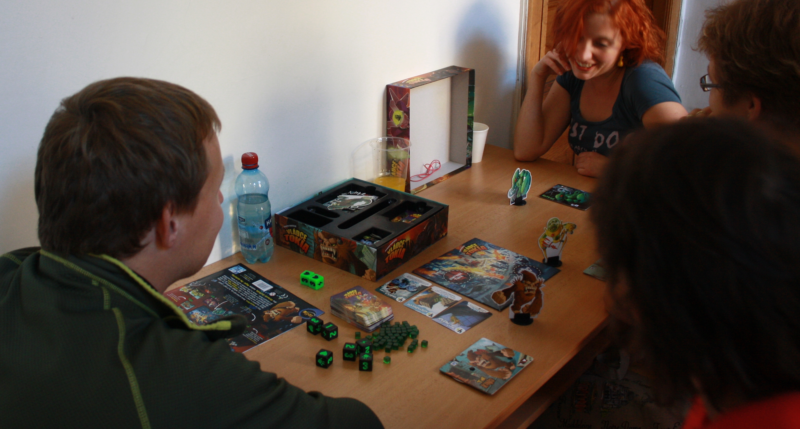

Slide 3
What are the main challenges?
Why did I think the 2019 exam was more difficult than previous exams?

Slide 4
Card games made as computer games
Hearthstone (regular or battlegrounds)
https://playhearthstone.com/en-us/battlegrounds/
Slay the spire
https://slay-the-spire.fandom.com/wiki/Cards
King of Tokyo: Power Up! was clearly not made as a computer game
Humans are way better at ”special conditions” compared to computers.

Slide 5
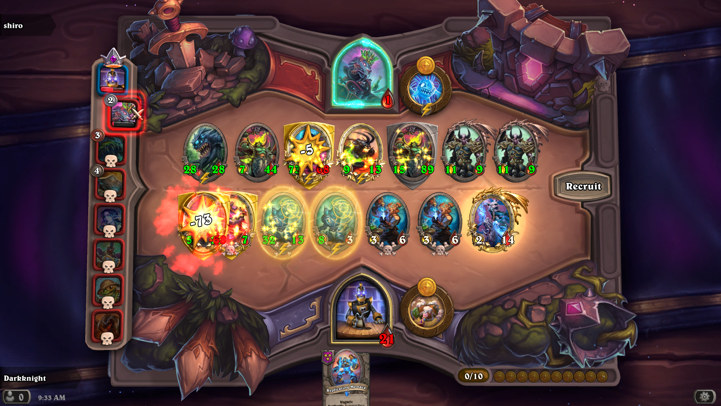

Slide 6
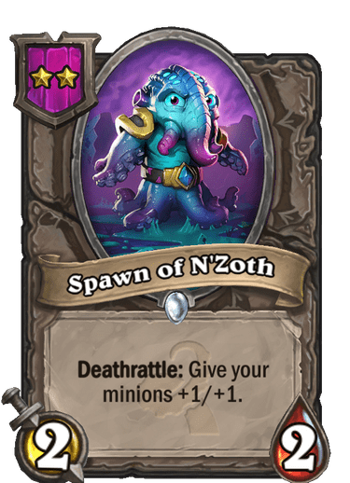
Where do we locate functionality?
Each card is its own class using the Command pattern?
public class Spawn extends Card {
@Override
public void onDeath() {
for(Card c : myMinions) {
c.modHealth(1);
c.modAttack(1);
}
}
}
Consequences:
Does it make sense for a Card to have a connection to everything that could potentially be modified and affected by a Card effect in the game? (myMinions, enemyMinions, etc.)
Does not utilize common effects (Deathrattle, Battlecry, etc.)
Duplicated code between cards, possibly avoidable with inheritance but then introduces strong coupling

Slide 7
Where do we locate functionality?
Each card is just a specification (JSON/XML/other) and logic is handled centrally?
[
{
”cardName” : ”Spawn of N’Zoth”,
”art” : ”spawnofnzoth.png”,
”description” : ”<b>Deathrattle:</b> Give your minions +1/+1”,
”effects” : [
{
”effect” : ”Deathrattle”,
”health” : ”+1”,
”attack” : ”+1”,
”targets” : [
”allFriendly”
],
”trigger” : ”Death”
}
]
}, …
Consequences:
Requires well-defined card-behavior and effects (targets, triggers, affected parameters, etc.) or the implementation will become unmanageable with special cases.
Really simple to add new cards when reoccurring effects (Battlecry, Deathrattle, Taunt, onOtherMinionPlayed, Other[group], etc.) can be used in specification.
Do we make one class responsible for being connected to every aspect that can be affected, or do we somehow split behavior between several classes?
How does this choice affect coupling, cohesion, primitiveness, and testability?

Slide 8
Where do we locate functionality?
Each card is its own conditional case in the game-loop (not recommended)
public void playLoop() {
//phase 1 – purchase and move cards
//phase 2 – battle-phase
for(int i=0; i<7; i++) {
Card attacker = randomPlayer.getMinions().getMinion(i)
if(attacker!=null) {
Card def = opponent.getMinions().getRandom(); //taunt?
if(def.dead(attacker) && def.equals(”Spawn of N’Zoth”)) {
for(Card c : opponent.getMinions()) {
c.modHealth(1);
c.modAttack(1);
}
} } } }
Consequences:
Code becomes unreadable if you add enough cards
Code becomes distributed across the class and it is not intuitive where to add new cards
There is no overview or oversight
Not testable, low cohesion, poor primitiveness, etc.

Slide 9
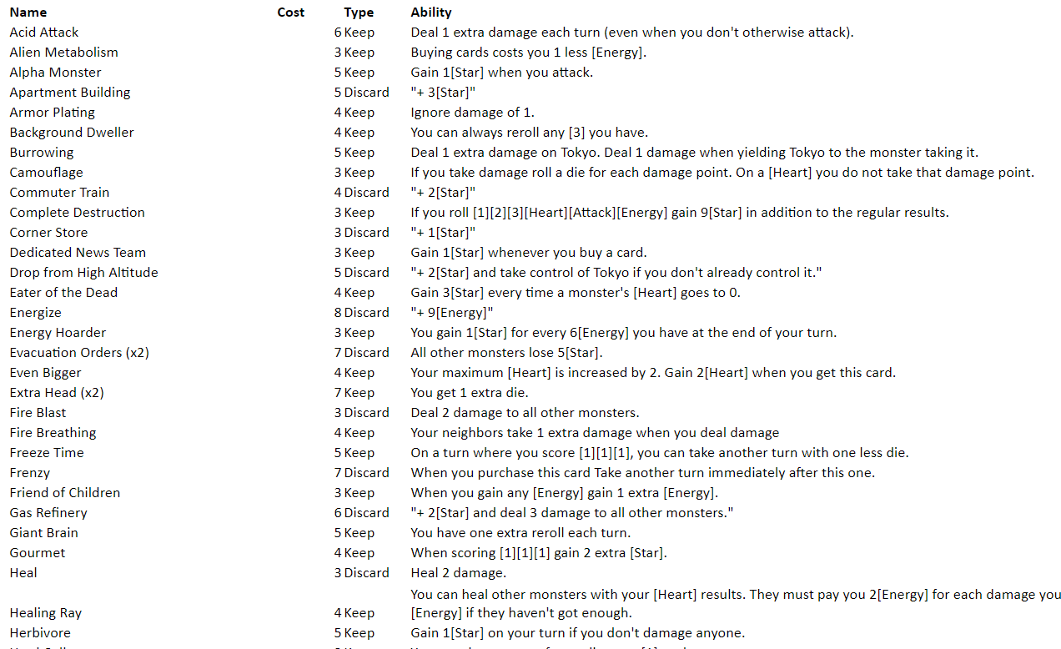
King of Tokyo – Store cards Limited set of effects…?
Modify attribute
Cost,
Stars,
Energy,
Dice-rolls,
Health
etc.
Target
Monster in Tokyo
All
Self
Deck
Dice
etc.
Trigger
…

Slide 10
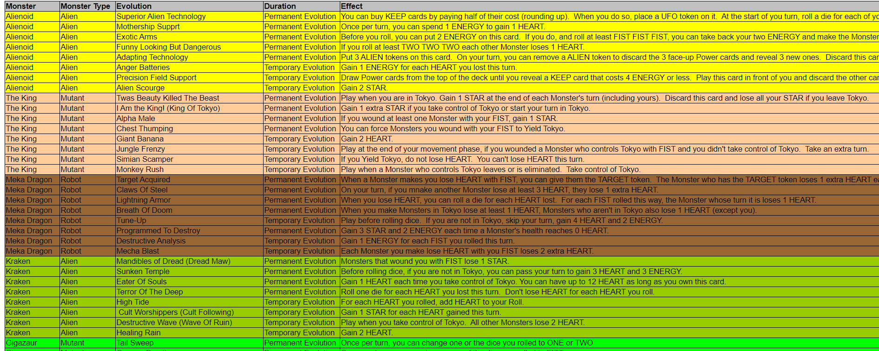
King of Tokyo – Evolution cards What do we do with this?

